Slide 1
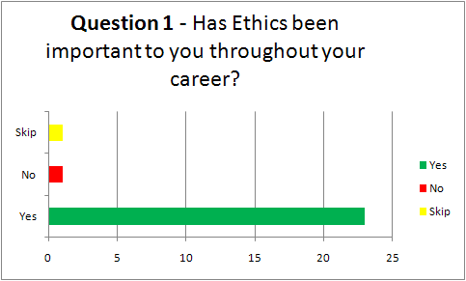
Parents Ethics Survey

Slide 2
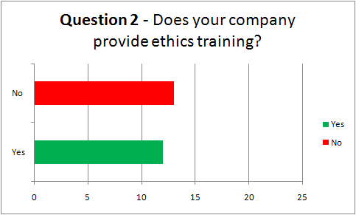
Parents Ethics Survey

Slide 3
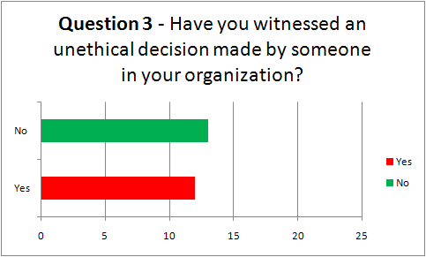
Parents Ethics Survey

Slide 4
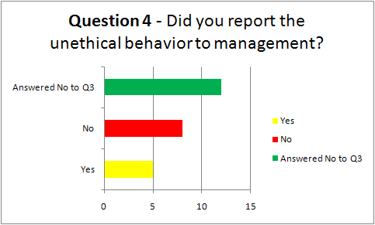
Parents Ethics Survey

Slide 5
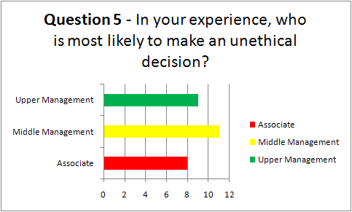
Parents Ethics Survey

Slide 6
Parents Ethics Survey - Advice
There is a lot to be said for putting in a hard and honest day's work. It makes you feel successful, professional and gives you a sense of confidence and accomplishment in your life. Being unethical only leads to disaster - your actions may haunt you and distract you from becoming a successful individual. Follow your gut feelings - if it doesn't feel right - it probably isn't. If your job is on the line, you should ask yourself what kind of company you are working for and how the company conducts business and if you want to be a part of company that is unethical. Be honest, loyal and hardworking and you will be rewarded.
Your name is the most important thing to you, jobs can change but your actions are remember forever. Integrity is doing the RIGHT thing when no one is looking.
Learn the ethical standards your company upholds, follow those ethical standards, and hold others accountable to those standards as well. Always lead by example and do the right thing even if you think no one is watching or will notice.

Slide 7
Parents Ethics Survey - Advice
Your name is the most important thing to you, jobs can change but your actions are remember forever. Integrity is doing the RIGHT thing when no one is looking.
Learn the ethical standards your company upholds, follow those ethical standards, and hold others accountable to those standards as well. Always lead by example and do the right thing even if you think no one is watching or will notice.

Slide 8
Parents Ethics Survey - Advice
Integrity, honesty and trust are very important in the long run and make you a valuable asset to the company. Do not compromise your values for a promotion etc. It will come back to haunt you at some point.
Don't take the easy route. Have patience, work hard, rely on professionalism & good things will come.
Stay true to your ideals and work with ambition and passion and advancement will go well.
Understand that there is always someone watching. Do the right thing, and stay away from people in our organization that you see making the wrong types of decisions.

Slide 9
Parents Ethics Survey - Advice
Don't compromise your values and always do what is ethically responsible, otherwise it will come back and you later face the consequences of your actions and decisions - it never stops.
Follow the ethics code provided to you by your company. If a code is not provided be honest in everything you do. At the end of the day all you have is your word and clients will respect/trust your honesty.
Sometimes you have to bend the rules a little to get people to do what you need them to do, and it can help to get respect from them.

Slide 10
Be honest, but be sure to cover yourself from those that aren't.
In your professional life as well as your personal life it is all about "relationships". Your behavior in them must reflect the principals and values you hold dear. If you are ethical in your dealings with others you will not go unnoticed.
Always strive to do the right thing. As a professional, especially one certified by the state, you have a duty to the public and your employer to act in an ethical manner. Not only is it the right thing to do, but you will also be protecting your professional reputation. Once this has been compromised it is very difficult to put right.

Slide 11
My advice is to be aware of both the ethics policy and ethics language in contract templates. Most large companies have an Ethics Officer or a Fraud/Ethics Hotline. Professional People need to be ethical in both fact and appearance. Perception and reality are the same through the eyes of third parties.
Don't take the easy route. Have patience, work hard, rely on professionalism & good things will come.
Integrity, honesty and trust are very important in the long run and make you a valuable asset to the company. Do not compromise your values for a promotion etc. It will come back to haunt you at some point.
Stay true to your ideals and work with ambition and passion and advancement will go well.

